Slide 1


Slide 2
IMP Note to Students
It is important to know that just login to the session does not guarantee the attendance.
Once you join the session, continue till the end to consider you as present in the class.
IMPORTANTLY, you need to make the class more interactive by responding to Professors queries in the session.
Whenever Professor calls your number / name ,you need to respond, otherwise it will be considered as ABSENT

Slide 3
Course Name :
Middleware Technologies CSIW ZG524

Slide 4
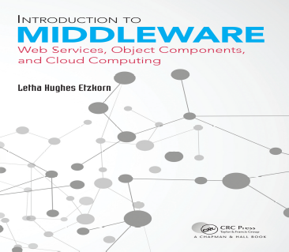
Textbooks
T1: Letha Hughes Etzkorn - Introduction to middleware _ web services, object components, and cloud computing-Chapman and Hall_CRC (2017).
T2: William Grosso - Java RMI (Designing & Building Distributed Applications)
R1: Gregor Hohpe, Bobby Woolf - Enterprise Integration Patterns_ Designing, Building, and Deploying Messaging Solutions -Addison-Wesley Professional (2003)
R2: MongoDB in Action
Note: In order to broaden understanding of concepts as applied to Indian IT industry, students are advised to refer books of their choice and case-studies in their own organizations

Slide 5
Modular Structure
No | Title of the Module
M1 | Introduction and Evolution
M2 | Enterprise Middleware
M3 | Middleware Design and Patterns
M4 | Middleware for Web-based Application and Cloud-based Applications
M5 | Specialized Middleware

Slide 6
CS3: Enterprise Application Integration
Challenges, Patterns, Solutions

Slide 7
CS2: CORBA - Common Object Request Broker Architecture

Slide 8
Agenda
CORBA
CORBA vs RMI
Inter-ORB Protocols
Object Bus and References
CORBA Naming Services
CORBA Object Services
JAVA CORBA Facility

Slide 9
CORBA
The Common Object Request Broker Architecture (CORBA) is a standard architecture for a distributed objects system.
CORBA is designed to allow distributed objects to interoperate in a heterogeneous environment, where objects can be implemented in different programming language and/or deployed on different platforms
CORBA is not itself a distributed objects facility; instead, it is a set of protocols.
A distributed object facility which adhere to these protocols is said to be CORBA-compliant, and the distributed objects that the facility support can interoperate with objects supported by other CORBA-compliant facilities.
CORBA is a very rich set of protocols. We will instead focus on the key concepts of CORBA related to the distributed objects paradigm. We will also study a facility based on CORBA: the Java IDL.

Slide 10
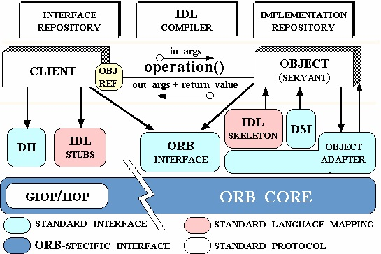
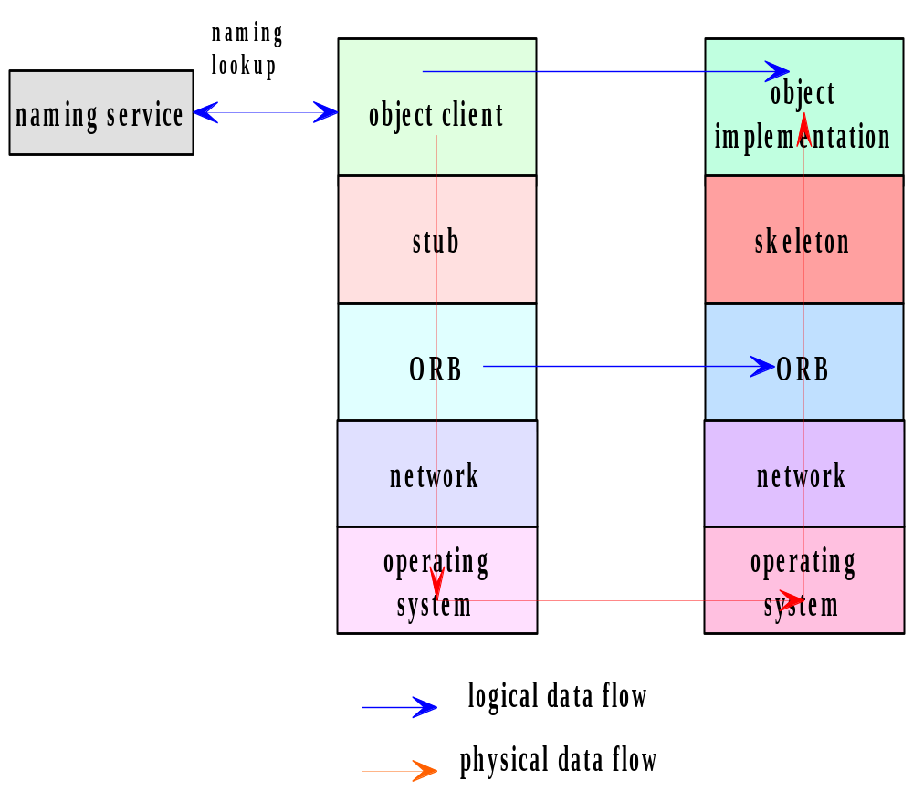
Architecture
CORBA Architecture and Workflow
Basic Workflow

Slide 11
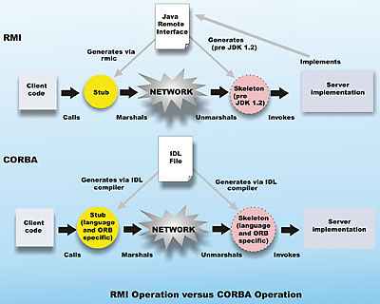
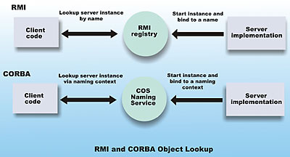
CORBA vs RMI
CORBA differs from the architecture of Java RMI in one significant aspect:
  RMI is a proprietary facility developed by Sun MicroSystems, Inc., and supports objects written in the Java programming language only.
  CORBA is an architecture that was developed by the Object Management Group (OMG), an industrial consortium.

Slide 12
CORBA Object Interface
A distributed object is defined using a software file similar to the remote interface file in Java RMI.
Since CORBA is language independent, the interface is defined using a universal language with a distinct syntax, known as the CORBA Interface Definition Language (IDL).
The syntax of CORBA IDL is similar to Java and C++. However, object defined in a CORBA IDL file can be implemented in a large number of diverse programming languages, including C, C++, Java, COBOL, Smalltalk, Ada, Lisp, Python, and IDLScript.
For each of these languages, OMG has a standardized mapping from CORBA IDL to the programming language, so that a compiler can be used to process a CORBA interface to generate the proxy files needed to interface with an object implementation or an object client written in any of the CORBA-compatible languages.

Slide 13
Inter-ORB Protocols
To allow ORBs to be interoperable, the OMG specified a protocol known as the General Inter-ORB Protocol (GIOP), a specification which “provides a general framework for protocols to be built on top of specific transport layers.”
A special case of the protocol is the Inter-ORB Protocol (IIOP), which is the GIOP applied to the TCP/IP transport layer.
The IIOP specification includes the following elements:
  Transport management requirements: specifies the connection and disconnection requirements, and the roles for the object client and object server in making and unmaking connections.
  Definition of common data representation: a coding scheme for marshalling and unmarshalling data of each IDL data type
  Message formats: different types of message format are defined. The messages allow clients to send requests to object servers and receive replies. A client uses a Request message to invoke a method declared in a CORBA interface for an object and receives a reply message from the server.

Slide 14
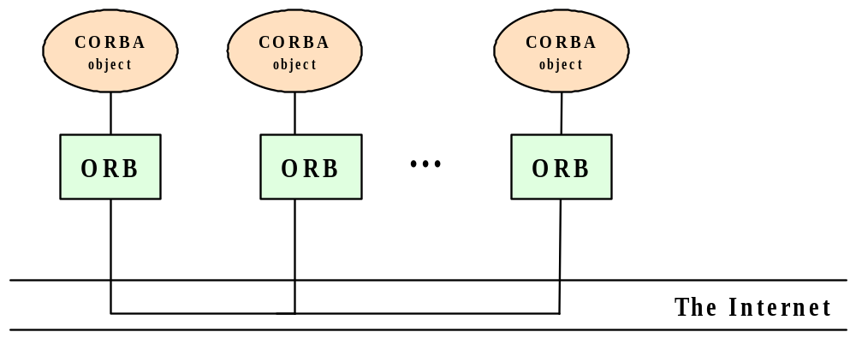
Object Bus
An ORB which adheres to the specifications of the IIOP may interoperate with any other IIOP-compliant ORBs over the Internet. This gives rise to the term “object bus”, where the Internet is seen as a bus that interconnects CORBA objects.
There are a large number of proprietary as well as experimental ORBs available:
(See CORBA Product Profiles, http://www.puder.org/corba/matrix/)
  Orbix IONA
  Borland Visibroker
  PrismTech’s OpenFusion
  Web Logic Enterprise from BEA
  Ada Broker from ENST
  Free ORB

Slide 15
CORBA Naming Service
CORBA specifies a generic directory service. The Naming Service serves as a directory for CORBA objects, and, as such, is platform independent and programming language independent.
The Naming Service permits ORB-based clients to obtain references to objects they wish to use. It allows names to be associated with object references. Clients may query a naming service using a predetermined name to obtain the associated object reference.
To export a distributed object, a CORBA object server contacts a Naming Service to bind a symbolic name to the object The Naming Service maintains a database of names and the objects associated with them.
To obtain a reference to the object, an object client requests the Naming Service to look up the object associated with the name (This is known as resolving the object name.)

Slide 16
CORBA Object Services
CORBA specify services commonly needed in distributed applications, some of which are:
  Naming Service:
  Concurrency Service:
  Event Service: for event synchronization;
  Logging Service: for event logging;
  Scheduling Service: for event scheduling;
  Security Service: for security management;
  Trading Service: for locating a service by the type (instead of by name);
  Time Service: a service for time-related events;
  Notification Service: for events notification;
  Object Transaction Service: for transactional processing.
Each service is defined in a standard IDL that can be implemented by a developer of the service object, and whose methods can be invoked by a CORBA client.

Slide 17
Java IDL – Java’s CORBA Facility
IDL is part of the Java 2 Platform, Standard Edition (J2SE).
The Java IDL facility includes a CORBA Object Request Broker (ORB), an IDL-to-Java compiler, and a subset of CORBA standard services.
In addition to the Java IDL, Java provides a number of CORBA-compliant facilities, including RMI over IIOP, which allows a CORBA application to be written using the RMI syntax and semantics.
Key Java IDL Packages
package org.omg.CORBA – contains interfaces and classes which provides the mapping of the OMG CORBA APIs to the Java programming language
package org.omg.CosNaming - contains interfaces and classes which provides the naming service for Java IDL
org.omg.CORBA.ORB - contains interfaces and classes which provides APIs for the Object Request Broker.

Slide 18
CS3: Enterprise Application Integration
Challenges, Patterns, Solutions

Slide 19
Agenda
Integration Challenges
Enterprise Information Systems
Enterprise Application Integration

Slide 20
What is Information Systems
Enterprise information systems:
  Integrated ISs that support core BPs and functions.
  e.g Marketing, Accounting, Finance, Info security, HR, Compliance, Production, Purchasing, and Logistics.
Examples of Information Systems:
Supply Chain Management − For managing suppliers, inventory and shipping, etc.
Human Resource Management − For managing personnel, training and recruiting talents;
Employee Health Care − For managing medical records and insurance details of employees;
Customer Relationship Management − For managing current and potential customers;
Business Intelligence Applications − For finding the patterns from existing data from business operations.
ERP: Enterprise resource planning
CPFR: Collaborative planning, forecasting, and replenishment
KM: Knowledge management

Slide 21
Need for Integration of Applications
All these systems work as individual islands of automation. Most often these systems are standalone and do not communicate with each other due to incompatibility issues such as
  Operating systems they are residing on;
  Database system used in the system;
  Legacy systems not supported anymore.
Main EIS need is for data integration (data sharing/ exchange):
  e.g, ERP & SCM improve SC; KM & CRM for (un)profitable customers
  All these are facilitated by communication!

Slide 22
EAI
EAI is an integration framework, a middleware, made of a collection of technologies and services
EAI allows smooth integration of all such systems and applications throughout the enterprise and enables data sharing and more automation of business processes.
Characteristics of EAI:
  EAI is defined as "the unrestricted sharing of data and business processes among any connected applications and data sources in the enterprise."
  Allows integration without any major changes to current infrastructure.
  Extends middleware capabilities to cope with application integration.
  Uses application logic layers of different middleware systems as building blocks.
  Keeps track of information related to the operations of the enterprise e.g. Inventory, sales ledger and execute the core processes that create and manipulate this information.

Slide 23
EAI
Need for EAI
  Unrestricted sharing of data and business processes across an organization.
  Linkage between customers, suppliers and regulators.
  The linking of data, business processes and applications to automate business processes.
  Ensure consistent qualities of service (security, reliability etc.).
  Reduce the on-going cost of maintenance and reduce the cost of rolling out new systems.
Challenges of EAI
  Hub and spoke architecture concentrates all of the processing into a single server/cluster.
  Often became hard to maintain and evolve efficiently.
  Hard to extend to integrate 3rd parties on other technology platforms.
  The canonical data model introduces an intermediary step.
  Added complexity and additional processing effort.
  EAI products typified.
  Heavy customization required to implement the solution.
  Lock-In − Often built using proprietary technology and required specialist skills.
  Lack of flexibility − Hard to extend or to integrate with other EAI products!
  Requires organization to be EAI ready.

Slide 24
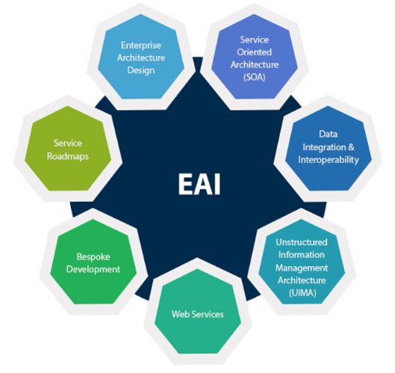
EAI Types
There are three main types of EAI:
  Presentation Integration Model
  Data Integration Model
  Functional Integration Mode
Data Level − Process, techniques and technology of moving data between data stores.
Application Interface Level − Leveraging of interfaces exposed by custom or packaged applications.
Method Level − Sharing of the business logic.
User Interface Level − Packaging applications by using their user interface as a common point of integration.

Slide 25
Integration Challenges
Enterprise integration is no easy task
Enterprise integration has to deal with multiple applications running on multiple platforms in different locations
EAI suites for Integration
Cross-platform, cross-language integration as well as the ability to interface
Enterprise integration requires a significant shift in corporate politics
A failing or misbehaving integration solution can cost a business millions of Dollars in lost orders, misrouted payments and disgruntled customers.
One important constraint of developing integration solutions is the limited amount of control the integration developers typically have over the participating applications.
Despite the wide-spread need for integration solutions, only few standards have established themselves in this domain
The advent of XML, XSL and Web services certainly mark the most significant advance of standards-based features in an integration solution.
While developing an EAI solution is challenging in itself, operating and maintaining such solution can be even more daunting.

Slide 26
ESB
ESB -“enterprise service bus,” is a software architecture that provides integration of enterprise applications and services for complex architectures, such as middleware infrastructure platforms.
An ESB's primary function is to provide the connections between communicating applications
  Acting much like a router to control the data. It is commonly used in enterprise application integration (EAI) or service-oriented architecture (SOA) principles.
  The interaction and communication between components are across the bus, which has a similar function as a physical computer bus to handle data transfer or message exchange between services without writing any actual code.
ESB as an infrastructure software service-oriented model works as a managed message system that provides routing, data transformation, translation upon a client's request and event-interpretation. It is often needed to transform messages into a format that the application can interpret. ESB is also used to change data content or execute services via a rule engine.

Slide 27
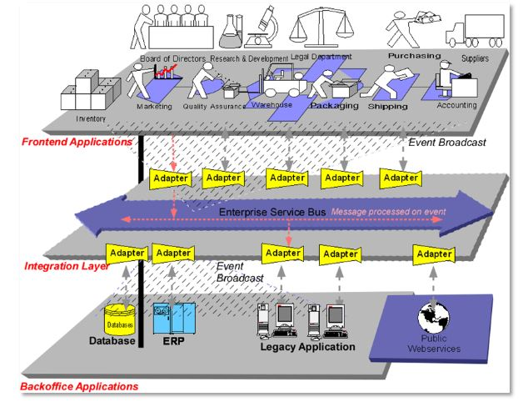
ESB

Slide 28
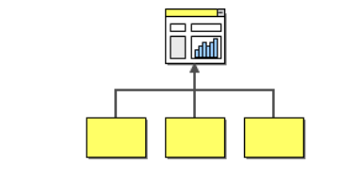
Integration Projects
Information Portals
Data Replication
Shared Business Functions
Service-Oriented Architectures
Distributed Business Processes
Business-to-Business Integration
Information Portals:
Many business users have to access more than one system to answer a specific question.
A customer service representative may have to access the order management system on the mainframe plus log on to the system that manages orders placed over the Web.

Slide 29
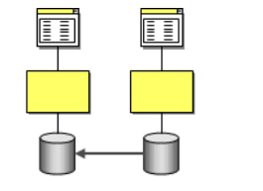
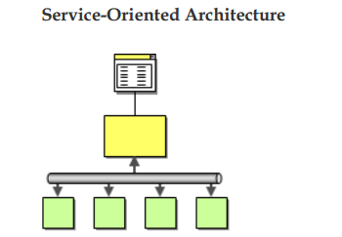
Integration Projects
Data Replication:
Many business systems require access to the same data.
Many of these systems are going to have their own data stores to store customer related information.
Service Oriented Architecture:
Shared business functions are often referred to as services.
A service is a well-defined function that is universally available and responds to requests from “service consumers”
Assembles a collection of useful services, managing the services becomes an important function.

Slide 30
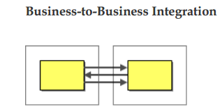
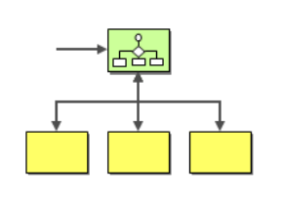
Integration Projects
Distributed Business Process:
One of the key drivers of integration is the fact that a single business transaction is often spread across many different systems.
Business process management component that manages the
execution of a business function across multiple existing systems.
Business Integration:
business functions may be available from outside suppliers or business partners
business may use an outside provider to
compute sales tax rates
above considerations apply equally to business-to-business integration

Slide 31
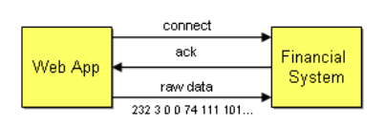
Integration Solutions
Tightly Coupled Integration Solution
Loosely Coupled Integration Solution
Tightly Coupled Integration:
Effects of tightly coupled dependencies.
How to resolve them?
Front-end Web application has to be integrated with the back-end financial
Easiest way is to use TCP/IP connectivity
Platform Technology – internal representations of numbers and objects
Location – hard-coded machine addresses
Time – all components have to be available at the same time
Data Format – the list of parameters and their types must match

Slide 32
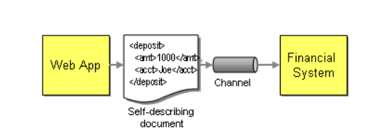
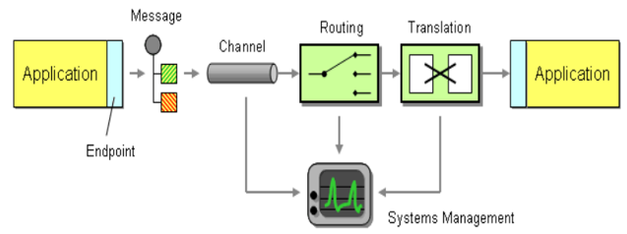
Loosely Coupled Integration
Mechanisms such as a common data format, queuing channels, and transformers help turn a tightly coupled solution into a loosely coupled solution.
The sender no longer has to depend on the receiver's internal data format not its location
computer is ready to accept requests or not
Code Complexity compared to tightly coupled system
Basic elements of Integration Solution
Loosely Coupled Integration

Slide 33
Patterns
Proxy
  Design pattern: representative for remote access
Factory
  Design pattern: object creation
Wrapper
  Design pattern: interface transformation
Interceptor
  Architectural pattern: adaptable service provision
These patterns appear very frequently in middleware construction

Slide 34
Proxy
Context
  Applications organized as a set of objects in a distributed environment; a client needs access to the services provided by some possibly remote object (the “servant”)
Problem
  Define an access mechanism that does not involve
    hard-coding the location of the servant into the client code
    deep knowledge of the communication protocols by the client
  Desirable properties
    Access should be efficient at run time and secure
    Programming should be simple for the client; ideally there should be no difference between local and remote access
  Constraints
    Distributed environment (no single address space)

Slide 35
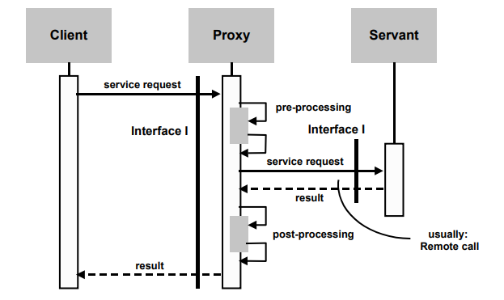
Proxy
Solutions
  Use a local representative of the server on the client site (isolates client from servant and communication system)
  Keep the same interface for the representative as for the servant
  Define a uniform proxy structure to facilitate automatic generation

Slide 36
Factory
Context
  Applications organized as a set of objects in a distributed environment
Problem
  Dynamically create multiple instances of a class
  Desirable properties
    Instances should be parameterized
    Evolution should be easy (no hard-coded decisions)
  Constraints
    Distributed environment (no single address space)

Slide 37
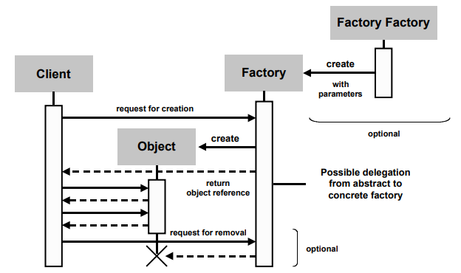
Factory
Solutions
  Abstract Factory: defines a generic interface and organization for creating objects; the actual creation is deferred to concrete factories that actually implement the creation methods
  Abstract Factory may be implemented using Factory Methods (a creation method that is redefined in a subclass)
  A further degree of flexibility is achieved by us

Slide 38
Wrapper (Adapters)
Context
  Clients requesting services; servers providing services; services defined by interfaces
Problem
  Reuse an existing server by modifying either its interface or some of its functions in order to satisfy the needs of a client (or class of clients)
  Desirable properties: should be run-time efficient; should be adaptable because the needs may change and may not be anticipated; should be itself reusable (generic)
  Constraints:

Slide 39
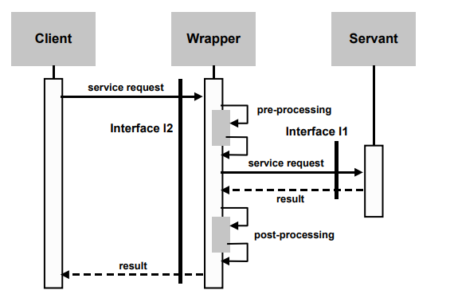
Wrapper (Adapters)
Solutions
  The wrapper screens the server by intercepting method calls to its interface. Each call is prefixed by a prologue and followed by an epilogue in the wrapper.
  The parameters and results may need to be converted.

Slide 40
Interceptor
Context
  Service provision (in a general setting)
    Client-server, Peer to peer, High-level to low-level
    May be uni- or bi-directional, synchronous or asynchronous
Problem
  Transform the service (adding new functions), by different means
    Interposing a new layer of processing (like wrapper)
    Changing the destination (may be conditional)
  Constraints
    Services may be added/removed dynamically

Slide 41
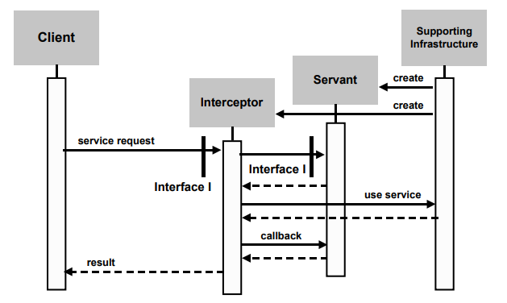
Interceptor
Solutions
  Create interposition objects (statically or dynamically). These objects
    Intercept calls (and/or returns) and insert specific processing, that may be based on contents analysis
    May redirect call to a different target
    May use callbacks

Slide 42
Similarities and Differences between Patterns
Wrapper vs Proxy
  Wrapper and Proxy have a similar structure
    Proxy preserves the interface; Wrapper transforms the interface
    Proxy often (not always) involves remote access; Wrapper is ususally on-site
Wrapper vs Interceptor
  Wrapper and Interceptor have a similar function
    Wrapper transforms the interface
    Interceptor transforms the functionality (may even completely screen the target)

Slide 43
Integration Patterns
Channel Patterns describe how messages are transported across a Message Channel. These patterns are implemented by most commercial and open source messaging systems.
Message Construction Patterns describe the intent, form and content of the messages that travel across the messaging system. The base pattern for this section is the Message pattern.
Routing Patterns discuss how messages are routed from a sender to the correct receiver. Message routing patterns consume a message from one channel and republish it message, usually without modification, to another channel based on a set of conditions. The patterns presented in this section are specializations of the Message Router pattern.

Slide 44
Integration Patterns
Transformation Patterns change the content of a message, for example to accommodate different data formats used by the sending and the receiving system. Data may have to be added, taken away or existing data may have to be rearranged. The base pattern for this section is the Message Translator.
Endpoint Patterns describe how messaging system clients produce or consume messages.
System Management Patterns describe the tools to keep a complex message-based system running, including dealing with error conditions, performance bottlenecks and changes in the participating systems.

Slide 45
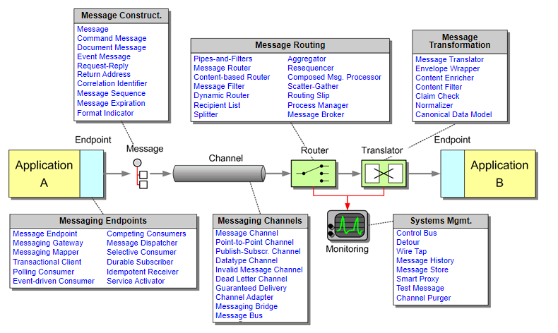
Messaging Patterns

Slide 46
Products Implement or Use EI Patterns?
The patterns are not tied to a specific implementation. They help you design better solutions, whether you use any of the following platforms:
EAI and SOA platforms, such as IBM WebSphere MQ, TIBCO, Vitria, Oracle Service Bus, WebMethods (now Software AG), Microsoft BizTalk, or Fiorano.
Open source ESB's like Mule ESB, JBoss Fuse, Open ESB, WSo2, Spring Integration, or Talend ESB
Message Brokers like ActiveMQ, Apache Kafka, or RabbitMQ
Web service- or REST-based integration, including Amazon Simple Queue Service (SQS) or Google Cloud Pub/Sub
JMS-based messaging systems
Microsoft technologies like MSMQ or Windows Communication Foundation (WCF)

Slide 47
Thank You

Slide 48


